Slide 1

Design of an artificial neural network to model the biological neurons for sound perception of crickets
Presented by – Kirteekumar Sonawane
Guided by – FH-Prof. Dipl.-Ing. Dr. Christian Netzberger
21-October -2021

Slide 2
INTRODUCTION
Sound perception mechanism in crickets brain.
Challenges
Tasks

Slide 3
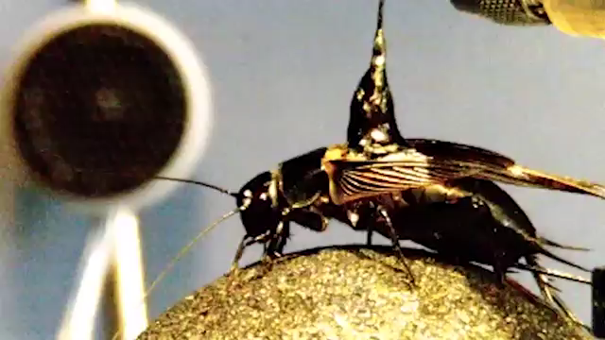
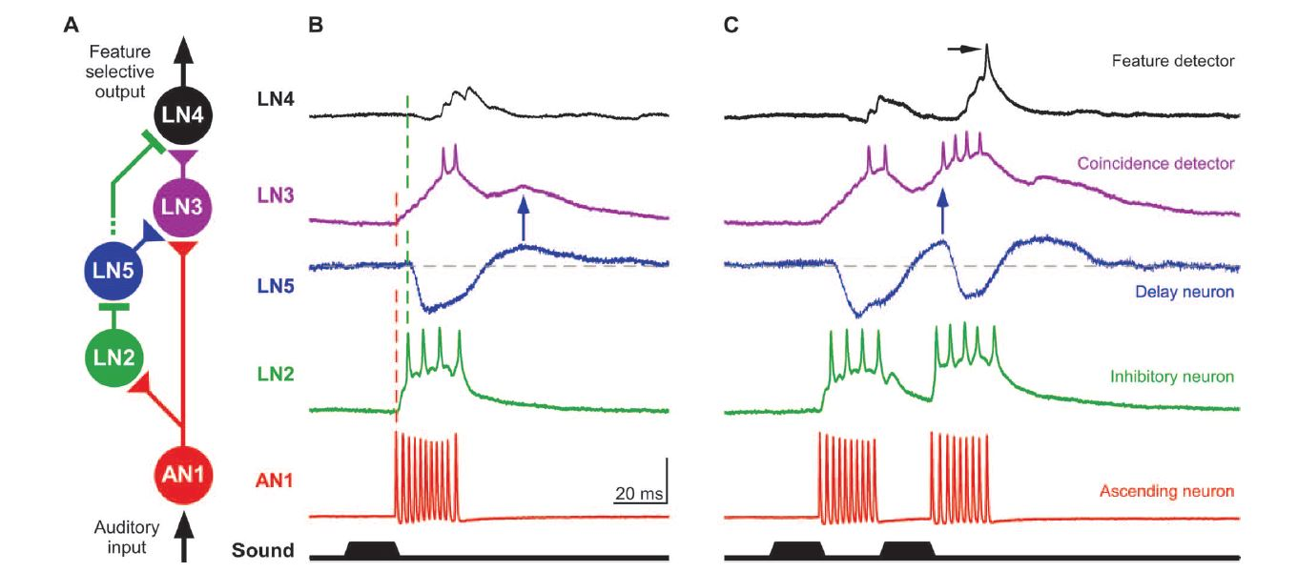
Sound perception mechanism in cricket brain
Measurement of the interneural data -
Proposed structure of sound perception network-

Slide 4
CHALLANGES
No similar example were found which predict sound data from sound data.
Availability of the limited data.
Interneural data was not suitable for model training.
Unsorted data - different sound patterns for different neurons.
Unsuitable slope for proper training.

Slide 5
TASKS
TASK 1 – Selection of neural network type and performing heuristics.
TASK 2 - Creating identical waveforms as of neuronal data for training and evaluating various neural network models.
TASK 3 - Training the neural network model for actual waveforms of neuronal data.
TASK 4 - Using that model, train all neurons and create a neural network.
TASK 5 - Make the real time predictions on PC by using created neural network model.

Slide 6
TASK 1
Heuristics

Slide 7
TASK 1 – Selection of neural network type and performing heuristics
CNN or RNN
CNN – Used for image processing.
RNN – Used for timeseries data.
LSTM
performing heuristics
Selected 100ms time of the AN1 waveform for training.
RNN topology – Many to one
Input parameters : Number of RNN units – 50 , epochs – 5
Rest of the parameters : Defaults or widely used.

Slide 8
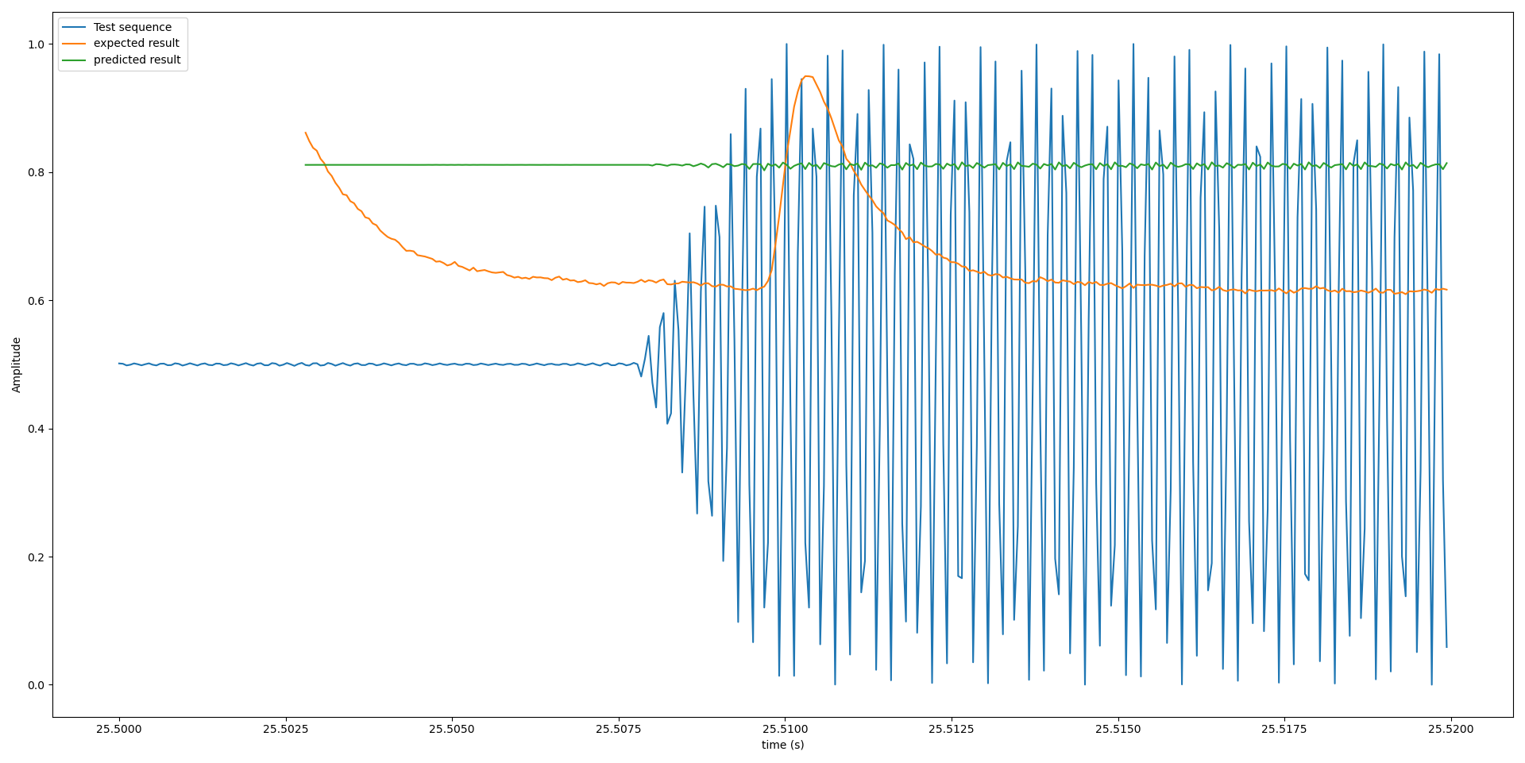
TASK 1 – Outcome of the heuristics
--- Modulated input
--- Expected output
--- Predicted output

Slide 9
TASK 1 – Results
Framework is ready.
RNN model topology– Many to one Many to Many.
Rest of the parameters – to be analysed.

Slide 10
TASKS
TASK 1 – Selection of neural network type and performing heuristics.
TASK 2 - Creating identical waveforms as of neuronal data for training and evaluating various neural network models.
TASK 3 - Training the neural network model for actual waveforms of neuronal data.
TASK 4 - Using that model, train all neurons and create a neural network.
TASK 5 - Make the real time predictions on PC by using created neural network model.

Slide 11
TASK 2
Training using artificial waveforms

Slide 12
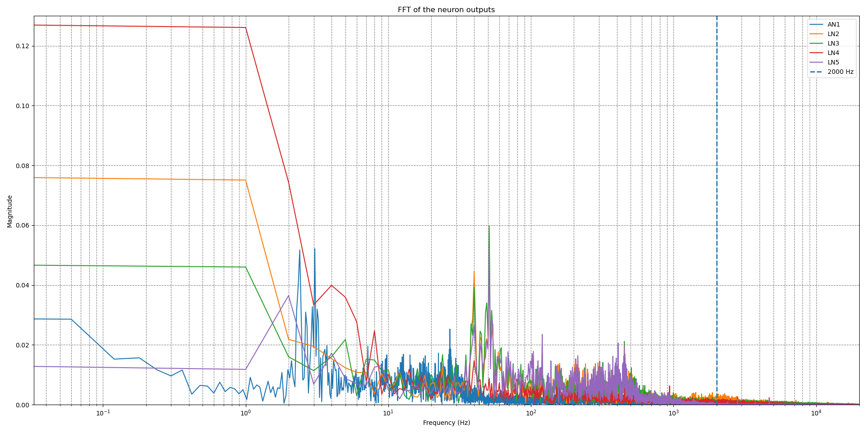
Actual neural waveform analysis for creating artificial waveforms for training.
Parameters | Original waveform | Training waveform
Sampling rate (Hz) | 17857 | 2000
Modulation frequency for inputs (Hz) | 4800 | 200
Output frequency (Hz) | 333 | 125
Delay between input and output (ms) | 30 | 10
Total number of timesteps in 50ms sample | 893 | 100

Slide 13
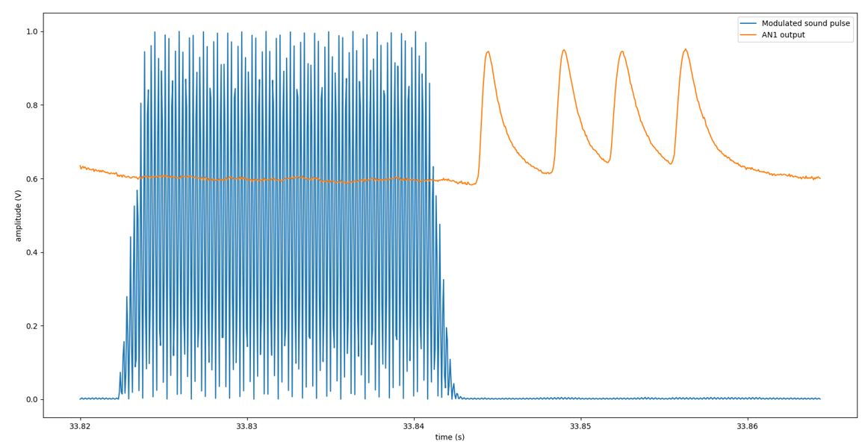
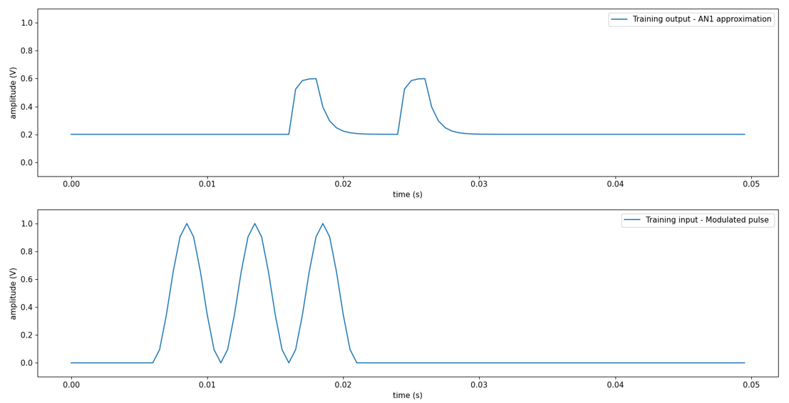
Original AN1 waveform
Artificial AN1 waveform

Slide 14
Simple LSTM configuration
t,X,y = generate_examples(1000,tm)
model = tf.keras.models.Sequential()
model.add(tf.keras.layers.LSTM(timesteps,return_sequences=False input_shape = (timesteps,n_features)))
model.add(tf.keras.layers.Dense(timesteps))
model.compile(loss=loss[i],optimizer='adam',metrics=['mae','acc’])
history = model.fit(X,y,epochs=epochs,verbose=verbose,batch_size=batch_size,validation_split=0.2)
Stacked LSTM configuration
t,X,y = generate_examples(1000,tm)
model = tf.keras.models.Sequential()
model.add(tf.keras.layers.LSTM(timesteps,return_sequences=True, input_shape = (timesteps,n_features))
model.add(tf.keras.layers.LSTM(timesteps))
model.add(tf.keras.layers.Dense(timesteps))
model.compile(loss=loss[i],optimizer='adam',metrics=['mae','acc’])
history = model.fit(X,y,epochs=epochs,verbose=verbose,batch_size=batch_size,validation_split=0.2)

Slide 15
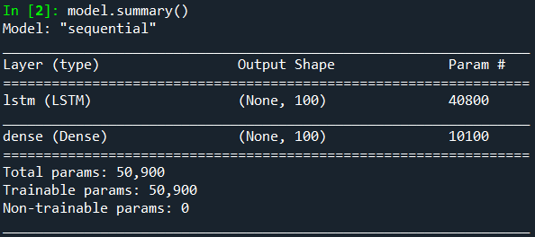
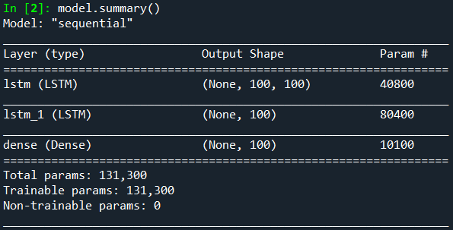
Simple LSTM configuration
Stacked LSTM configuration
After training for 100 epochs
Training time – 20 minutes approx
Achieved training accuracy – 80% approx
After training for 100 epochs
Training time – 40 minutes approx
Achieved training accuracy – 80% approx

Slide 16
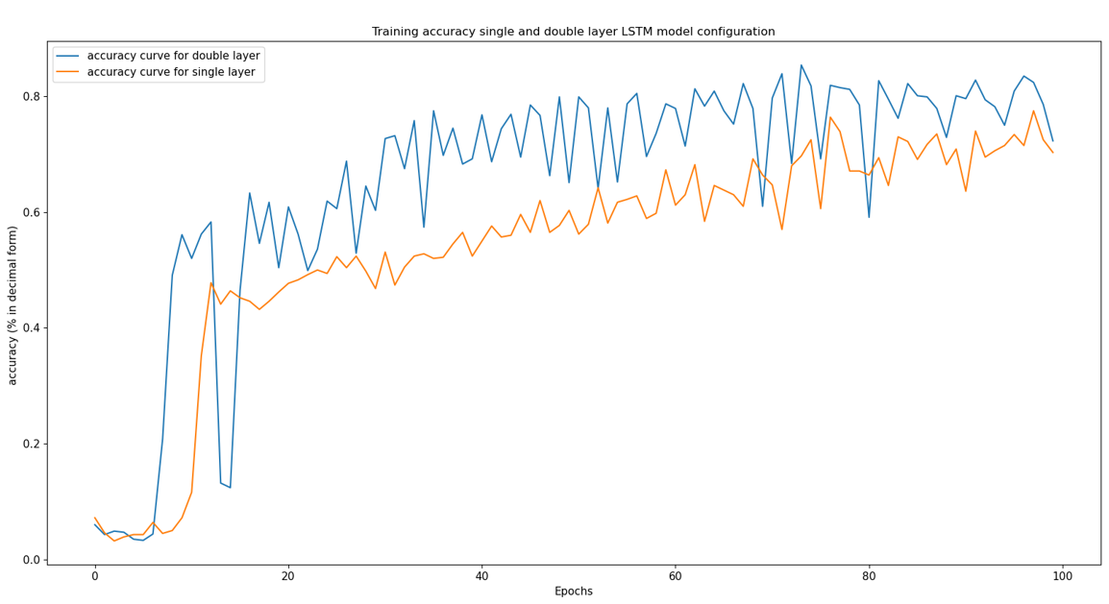
Accuracy comparison for simple and stacked LSTM models
--- Accuracy for double layer
--- Accuracy for single layer

Slide 17
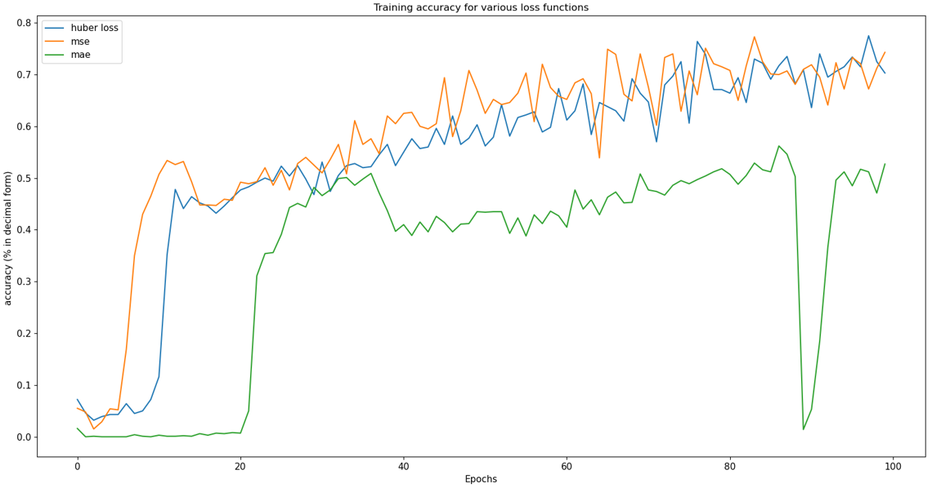
Evaluating various loss functions
--- Mean squared error
--- Mean absolute error
--- Huber loss

Slide 18
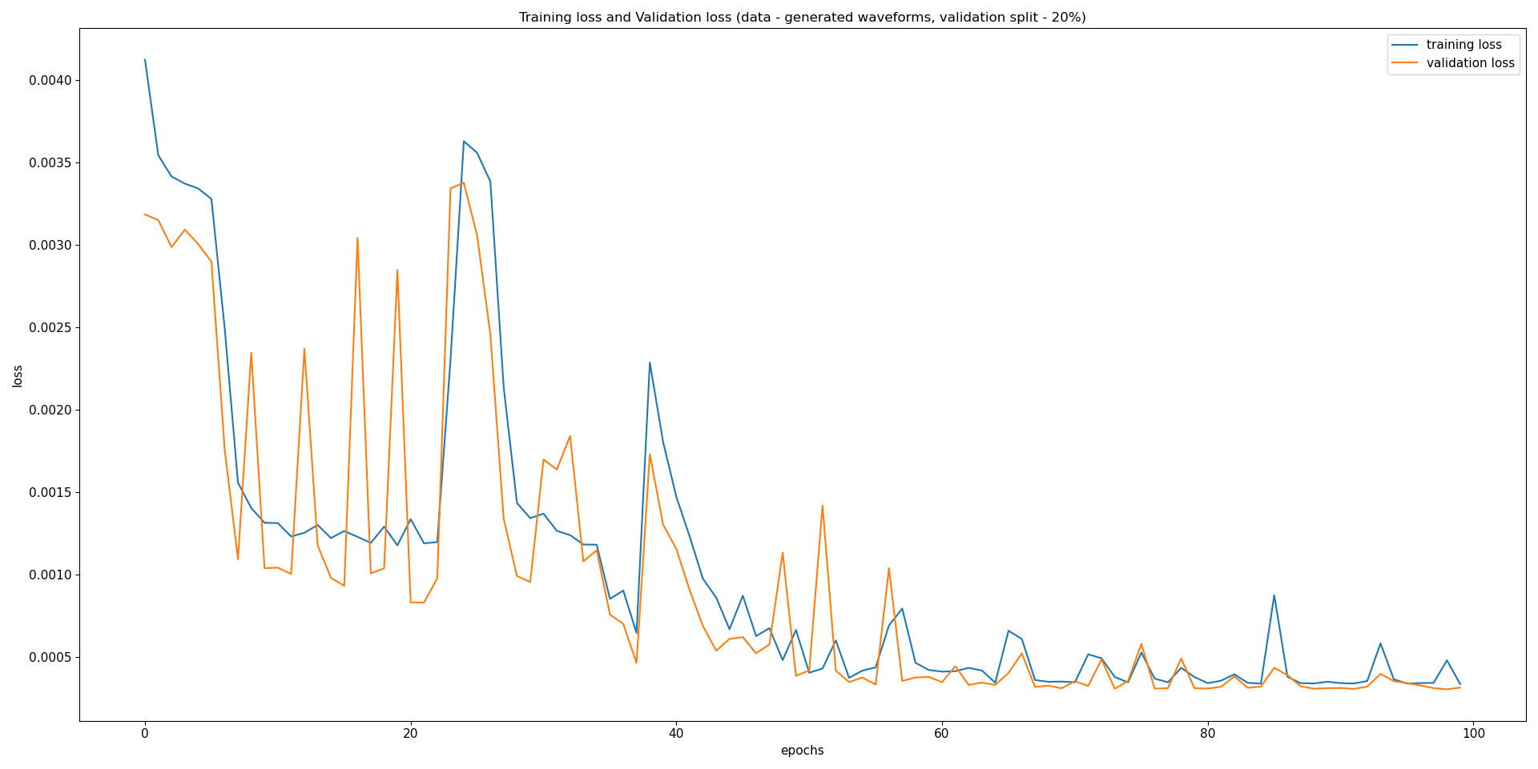
Loss curve in stacked LSTM
--- Training loss
--- Validation loss
--- Training loss
--- Validation loss

Slide 19
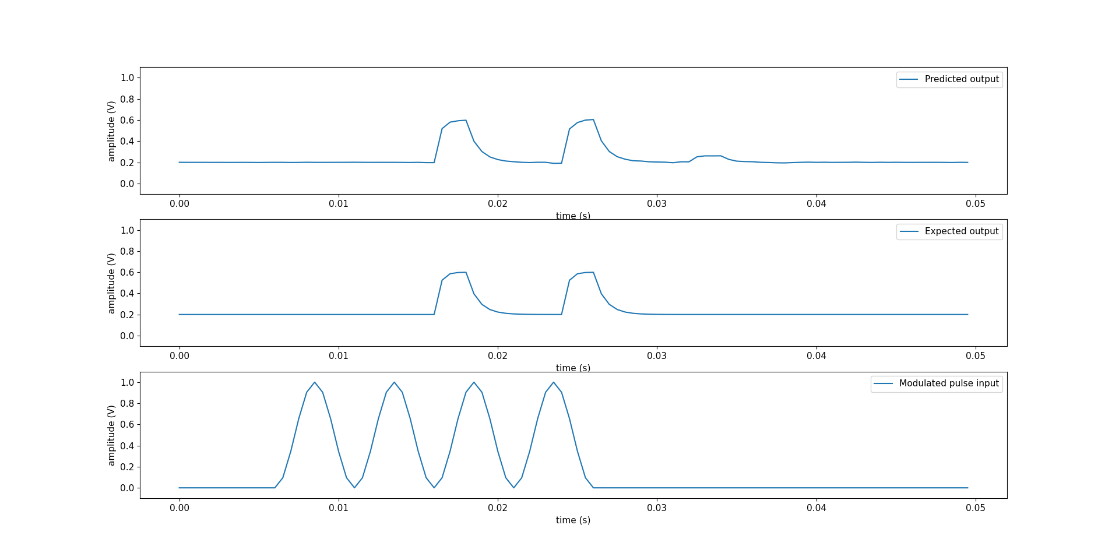
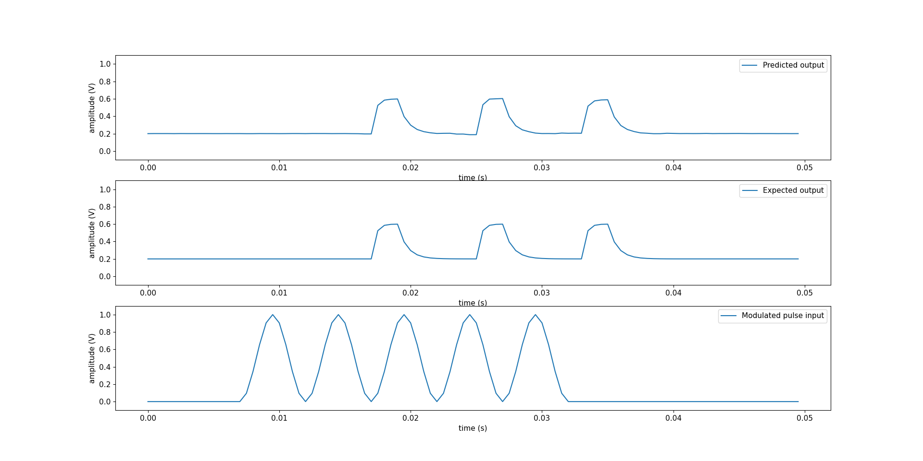
Predictions - Simple LSTM configuration
Predictions - Stacked LSTM configuration
Predicted o/p
Expected o/p
Input

Slide 20
TASK 2 – Results
Model topology – many to many
Sampling frequency 2000 Hz
Loss function – Huber loss
Training algorithm – Adam
Model configuration – Stacked LSTM.

Slide 21
TASKS
TASK 1 – Selection of neural network type and performing heuristics.
TASK 2 - Creating identical waveforms as of neuronal data for training and evaluating various neural network models.
TASK 3 - Training the neural network model for actual waveforms of neuronal data.
TASK 4 - Using that model, train all neurons and create a neural network.
TASK 5 - Make the real time predictions on PC by using created neural network model.

Slide 22
TASK 3
Training of real neural waveforms

Slide 23
TASK 3
Correcting the AN1 shape for the training.
Stacked LSTM model.
Encoder Decoder LSTM model.
Bidirectional LSTM model.

Slide 24
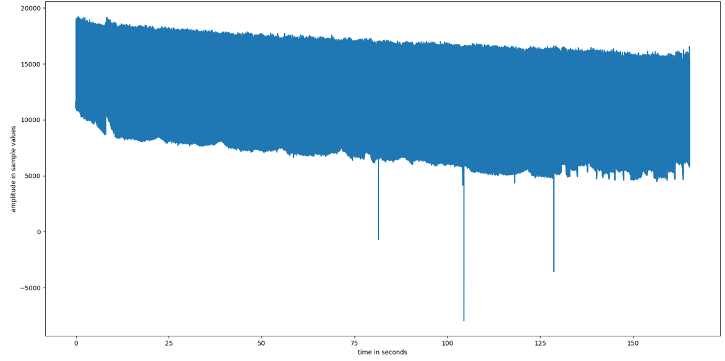
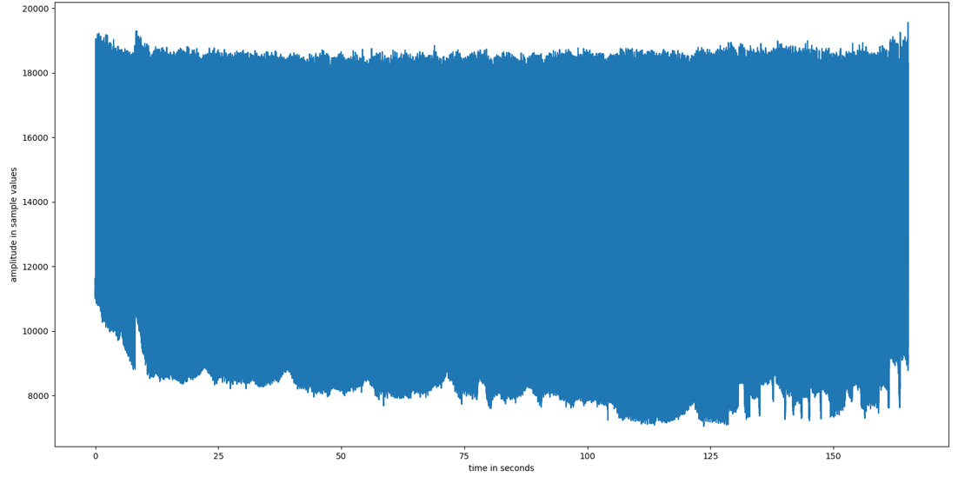
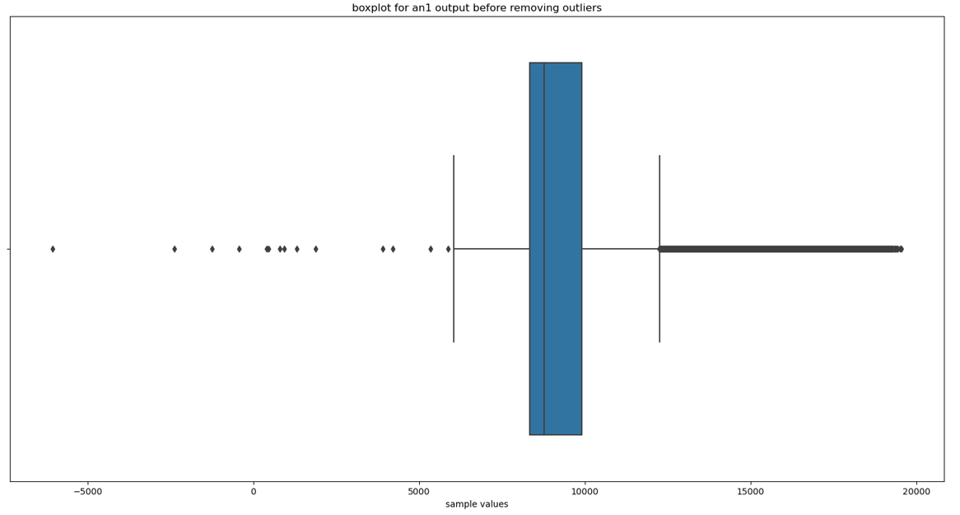
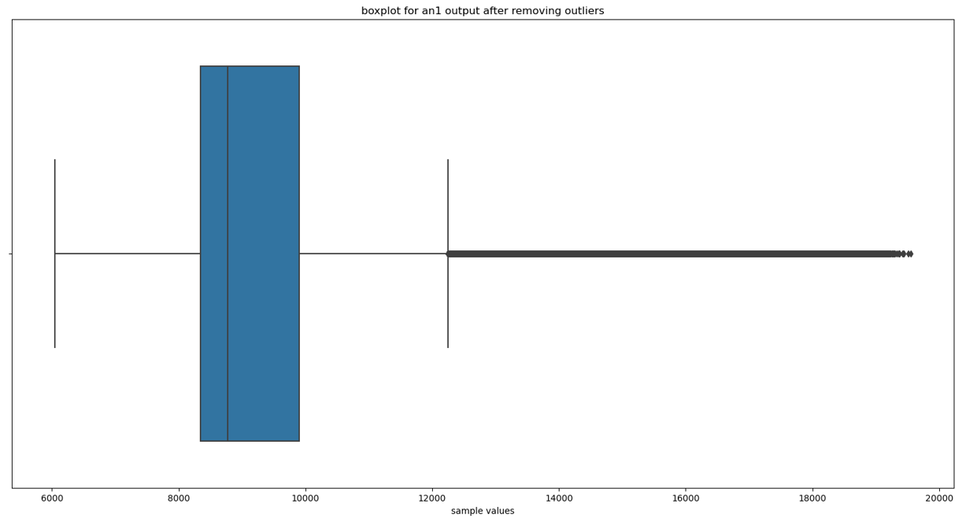
Correcting the AN1 shape for the training.

Slide 25
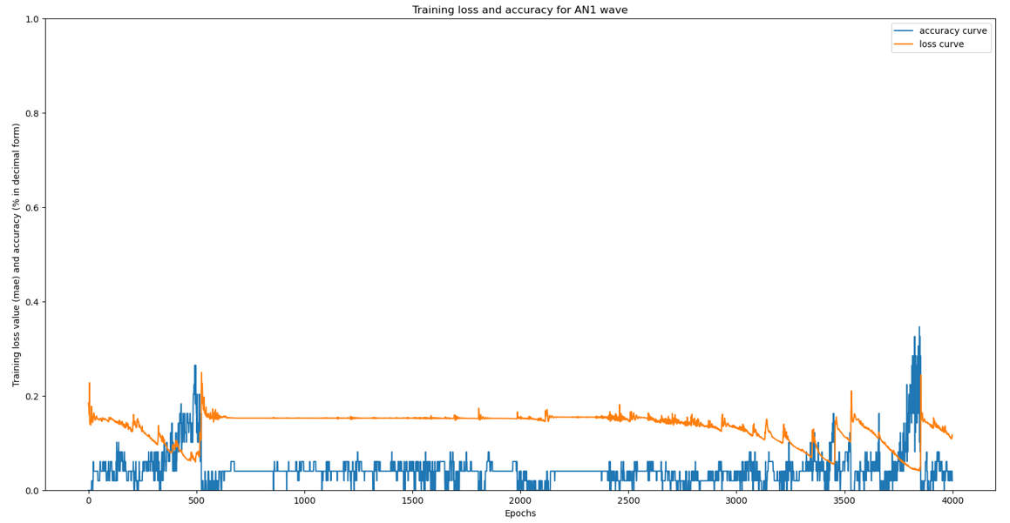
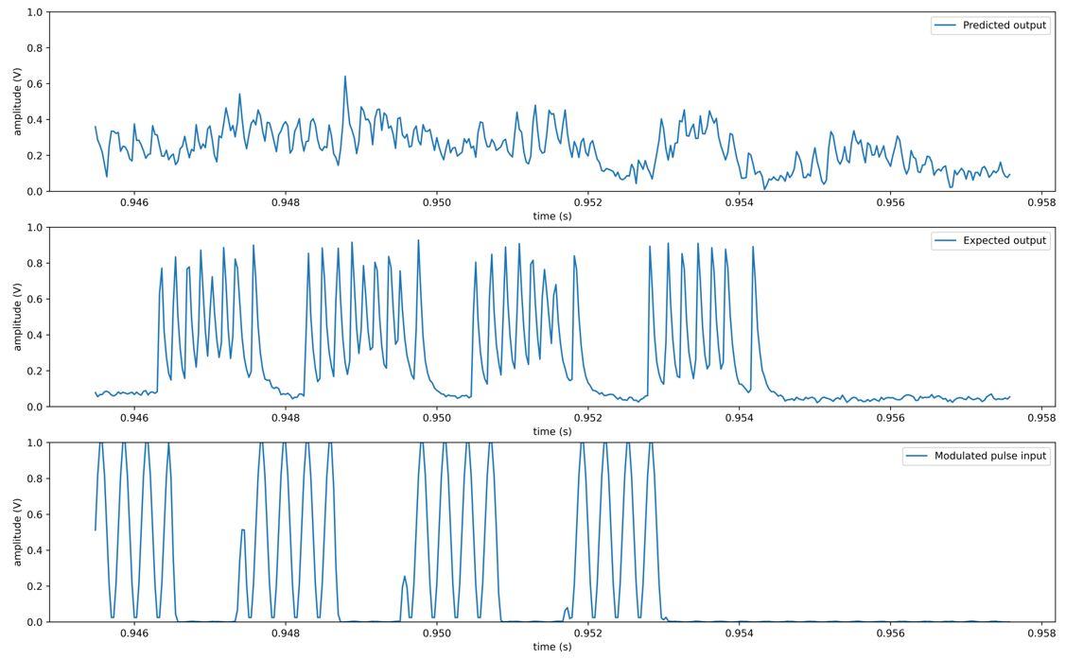
Stacked LSTM model.
Epochs – 4000
Training time – 7 hours approximately.
Loss and accuracy curves
Predictions
--- Accuracy curve
--- Loss curve
Predicted o/p
Expected o/p
Modulated input

Slide 26
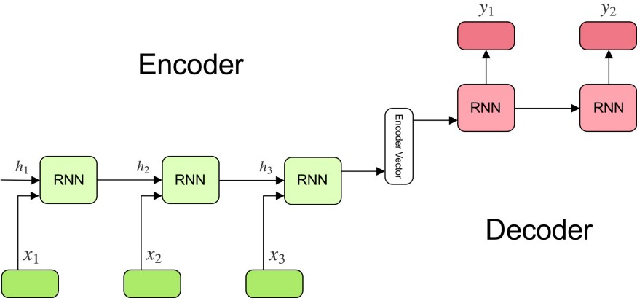
Encoder Decoder LSTM model.
Create a context by taking the information all at once.
From the context formed by input data, output is predicted iteratively.
Need to use Keras functional APIs

Slide 27
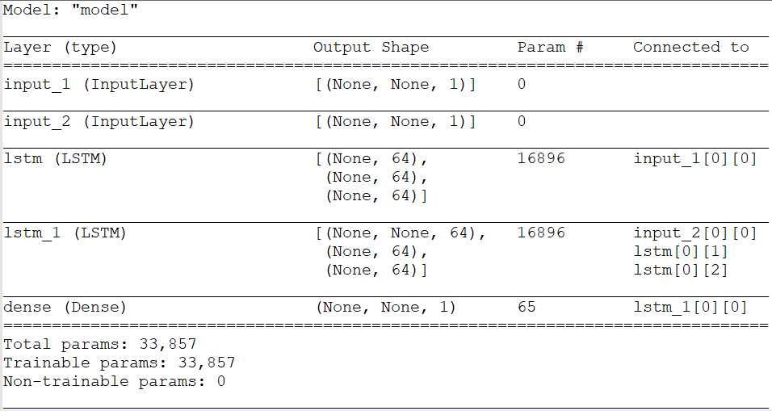
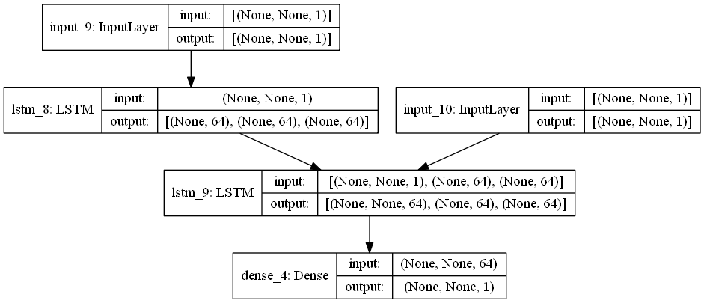
Encoder Decoder LSTM model – Training .
Code:
encoder_inputs = keras.Input(shape=(None, 1))
encoder = keras.layers.LSTM(latent_dim, return_state=True)
encoder_outputs, state_h, state_c = encoder(encoder_inputs)
# discard `encoder_outputs` and only keep the states.
encoder_states = [state_h, state_c]
# Set up the decoder, using `encoder_states` as initial state.
decoder_inputs = keras.Input(shape=(None, 1))
# set up the decoder to return full output sequences,
# and to return internal states as well. don't use the
# return states in the training model, but will use them in #inference.
decoder_lstm = keras.layers.LSTM(latent_dim, return_sequences=True, return_state=True)
decoder_outputs, _, _ = decoder_lstm(decoder_inputs, initial_state=encoder_states)
decoder_dense = keras.layers.Dense(1, activation="relu")
decoder_outputs = decoder_dense(decoder_outputs)
# Define the model that will turn
# `encoder_input_data` & `decoder_input_data` into #`decoder_target_data`
model = keras.Model([encoder_inputs, decoder_inputs], decoder_outputs)

Slide 28
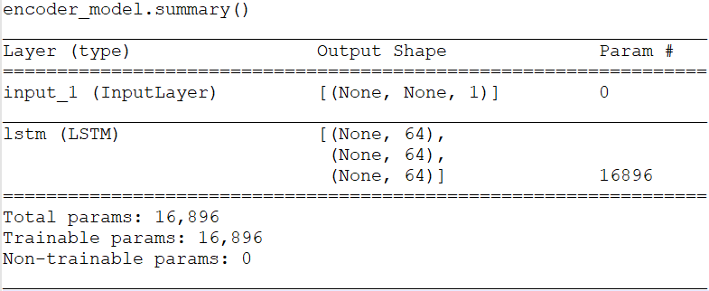
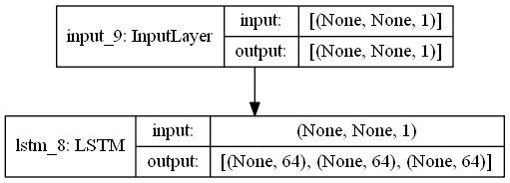
Encoder Decoder LSTM model –predictions (encoder).
Code:
encoder_inputs = model.input[0] # input_1
encoder_outputs, state_h_enc, state_c_enc = model.layers[2].output # lstm_1
encoder_states = [state_h_enc, state_c_enc]
encoder_model = keras.Model(encoder_inputs, encoder_states)
decoder_inputs = model.input[1] # input_2
decoder_state_input_h = keras.Input(shape=(latent_dim,), name="input_3")
decoder_state_input_c = keras.Input(shape=(latent_dim,), name="input_4")
decoder_states_inputs = [decoder_state_input_h, decoder_state_input_c]
decoder_lstm = model.layers[3]
decoder_outputs, state_h_dec, state_c_dec = decoder_lstm(decoder_inputs, initial_state=decoder_states_inputs)
decoder_states = [state_h_dec, state_c_dec]
decoder_dense = model.layers[4]
decoder_outputs = decoder_dense(decoder_outputs)
decoder_model = keras.Model([decoder_inputs] + decoder_states_inputs, [decoder_outputs] + decoder_states)

Slide 29
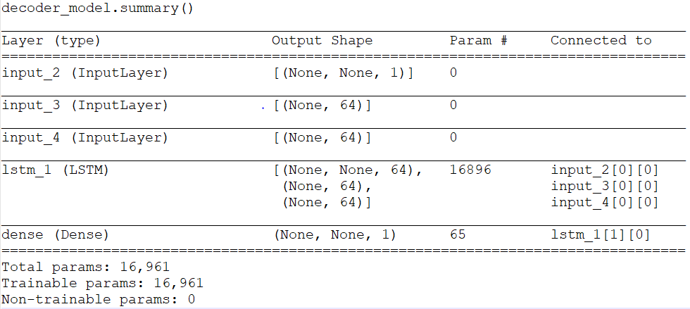
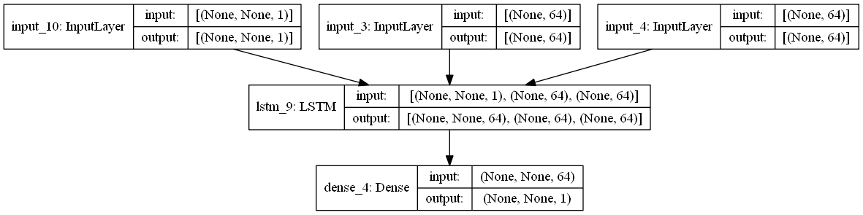
Encoder Decoder LSTM model –predictions (decoder).
Code:
decoder_inputs = model.input[1] # input_2
decoder_state_input_h = keras.Input(shape=(latent_dim,), name="input_3")
decoder_state_input_c = keras.Input(shape=(latent_dim,), name="input_4")
decoder_states_inputs = [decoder_state_input_h, decoder_state_input_c]
decoder_lstm = model.layers[3]
decoder_outputs, state_h_dec, state_c_dec = decoder_lstm(decoder_inputs, initial_state=decoder_states_inputs)
decoder_states = [state_h_dec, state_c_dec]
decoder_dense = model.layers[4]
decoder_outputs = decoder_dense(decoder_outputs)
decoder_model = keras.Model([decoder_inputs] + decoder_states_inputs, [decoder_outputs] + decoder_states)

Slide 30
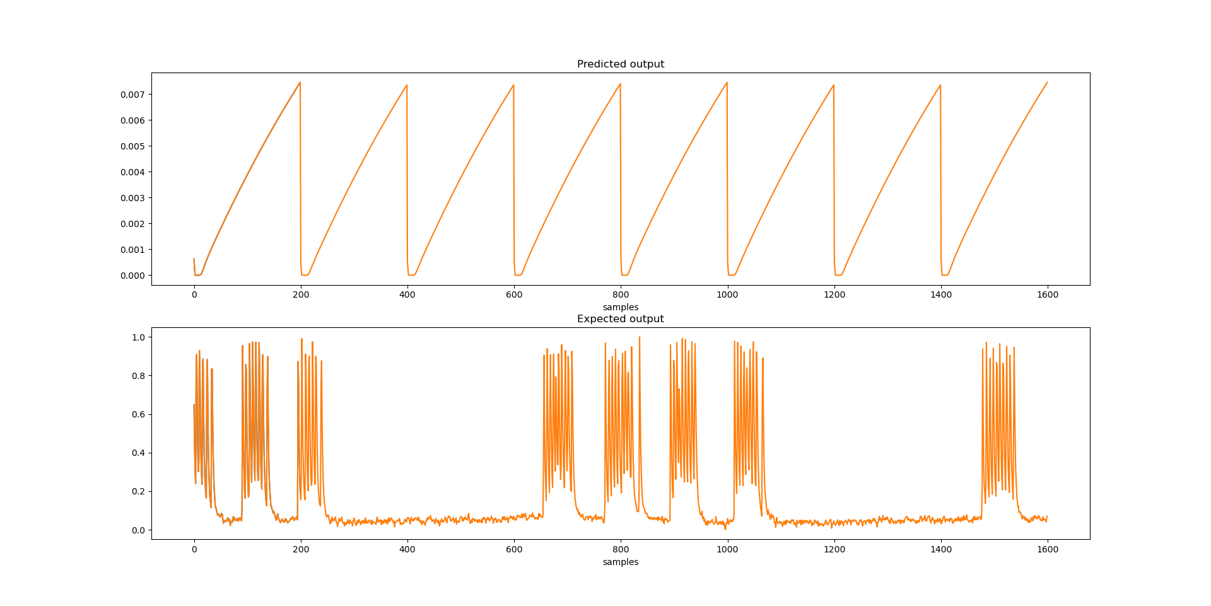
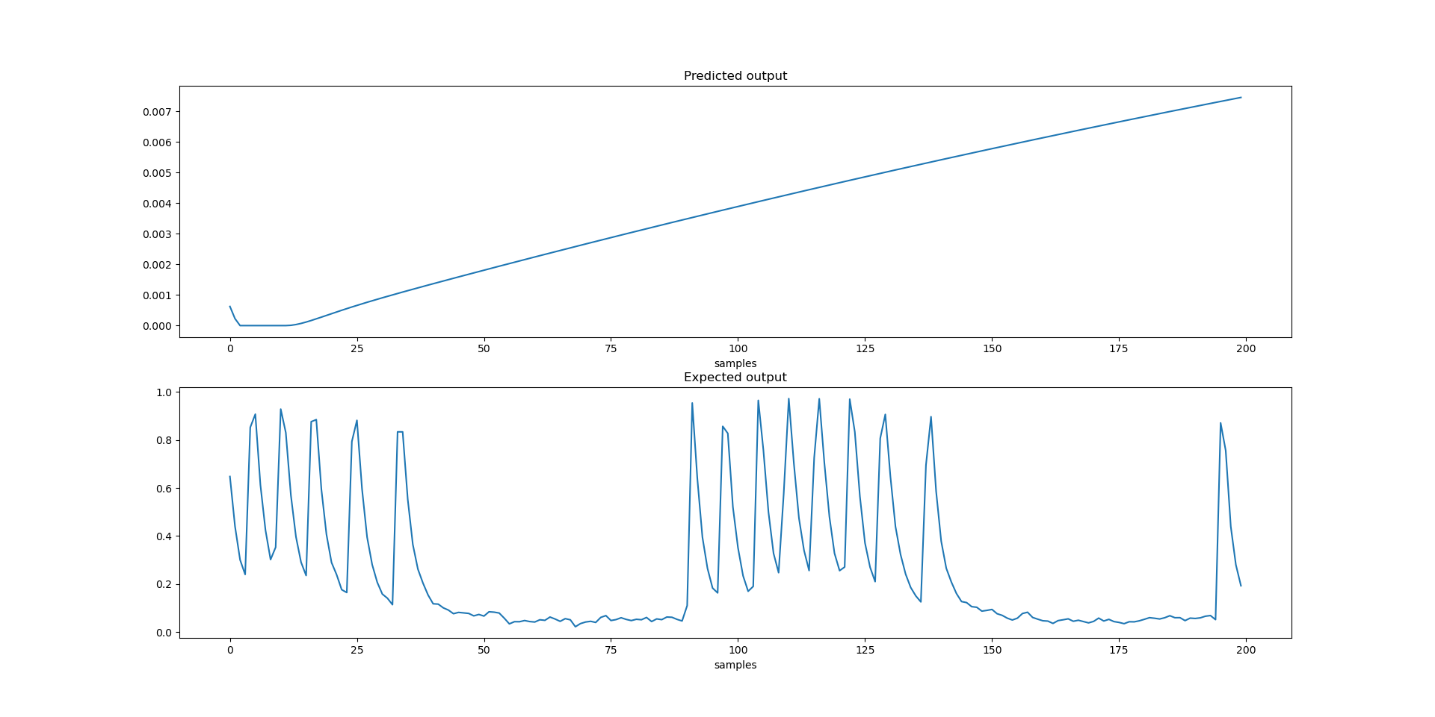
Encoder Decoder LSTM model – Results
Epochs – 100
Training time – 14 hours approximately.
Accuracy – 0%
7 seconds to predict 100ms of data.
Predictions
Predictions

Slide 31
Encoder Decoder LSTM model – Potential reasons for 0% accuracy
Context is remaining almost identical for different inputs – need more training time.
No one hot encoding the inputs.
Predictions
Predictions

Slide 32
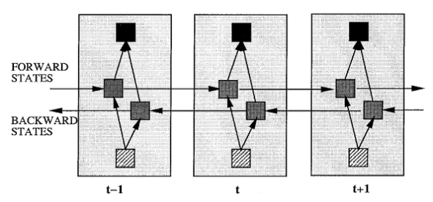
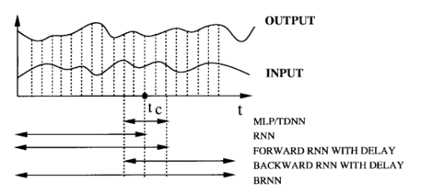
Bidirectional LSTM model.
The bidirectional LSTM model was developed for speech recognition
It splits the state neurons of a regular RNN in a part that is responsible for the positive time direction (forward states) and a part for the negative time direction (backward states).
A bidirectional recurrent neural network (BRNN) that can be trained using all available input information in the past and future of a specific time frame.

Slide 33
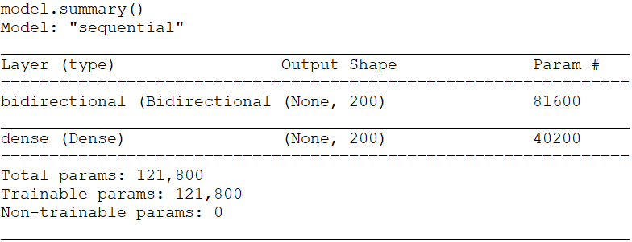
Bidirectional LSTM model.
Code:
model = tf.keras.Sequential()
model.add(Bidirectional(tf.keras.layers.LSTM(lstm_units), input_shape = (timesteps,n_features[i])))
model.add((tf.keras.layers.Dense(timesteps, activation= 'relu' )))
model.compile(loss= 'huber_loss' , optimizer= 'adam' , metrics=[ 'accuracy'])

Slide 34
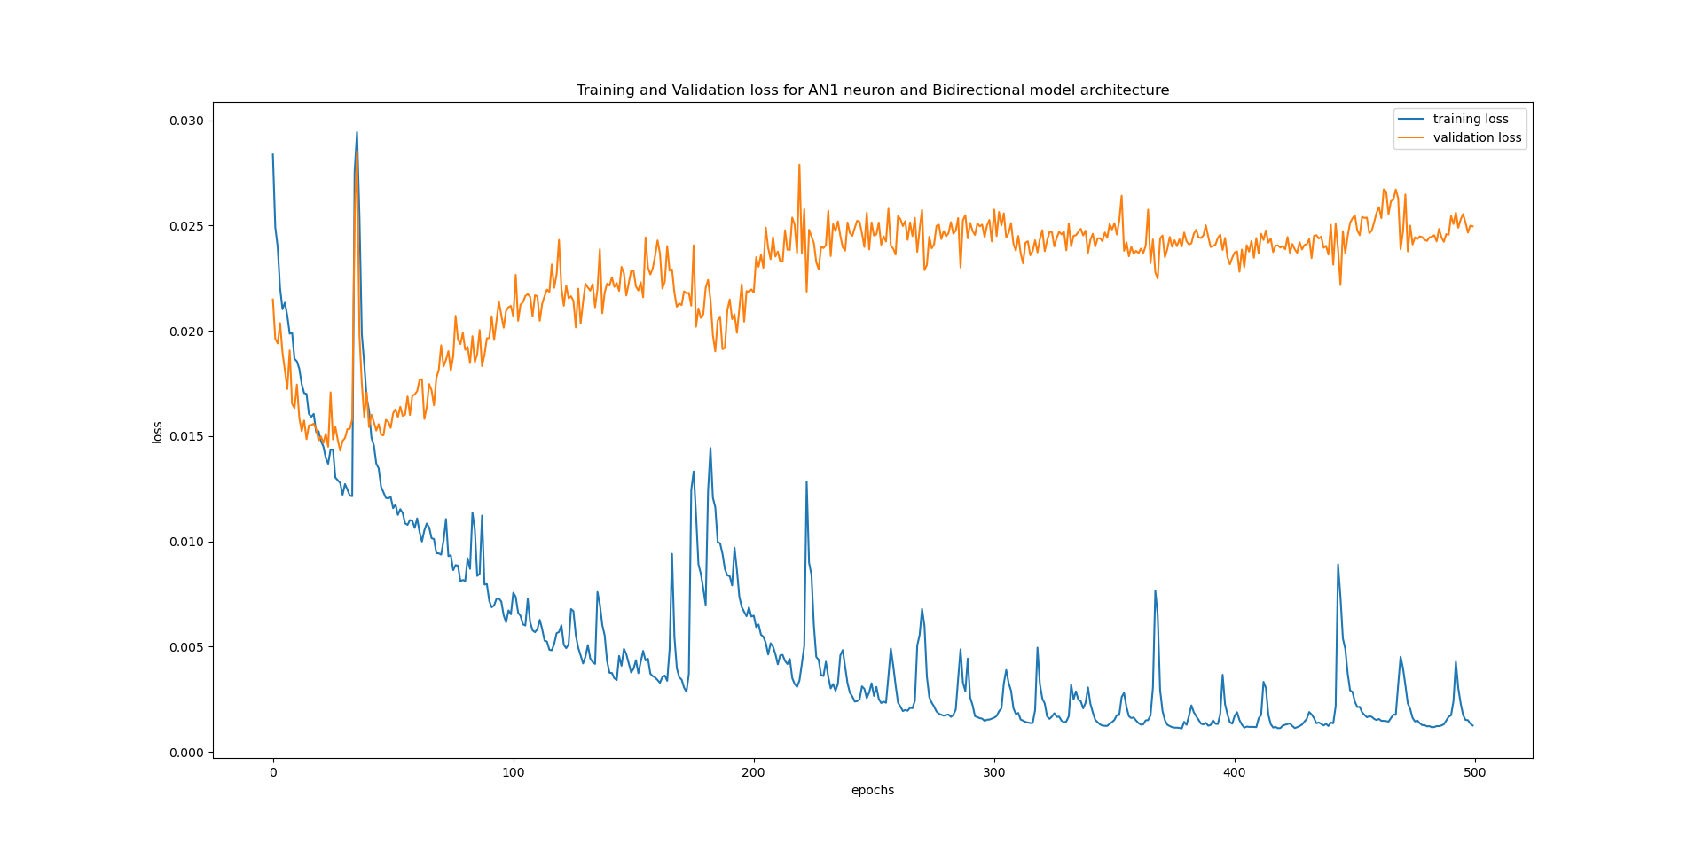
Bidirectional LSTM model – Results
Epochs – 500
Training time – 1 hour approximately.
Training accuracy – 33%
Validation accuracy – 3.3%
Loss curves
--- Training loss
--- Validation loss
--- Training loss
--- Validation loss

Slide 35
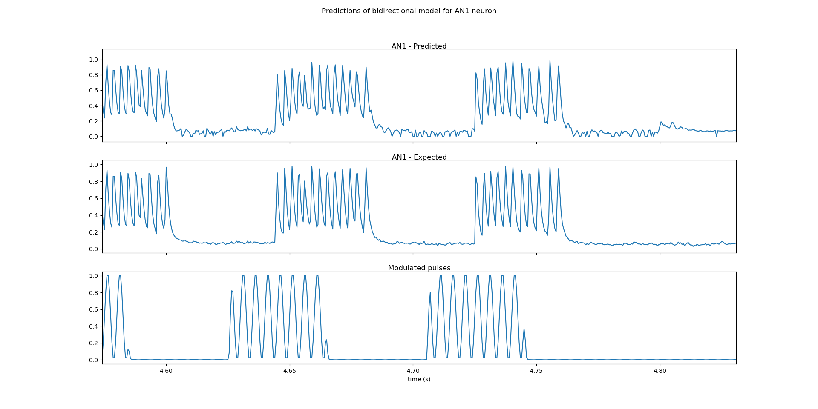
Bidirectional LSTM model – Predictions

Slide 36
TASKS
TASK 1 – Selection of neural network type and performing heuristics.
TASK 2 - Creating identical waveforms as of neuronal data for training and evaluating various neural network models.
TASK 3 - Training the neural network model for actual waveforms of neuronal data.
TASK 4 - Using that model, train all neurons and create a neural network.
TASK 5 - Make the real time predictions on PC by using created neural network model.

Slide 37
TASK 4
Train all the neurons and form a neural network

Slide 38
Resource analysis for increased sampling frequency
Number of timesteps = Number of LSTM units (For 100ms of data) | Time taken to run 1 epoch (In Seconds) | Projected time to run 500 epochs | memory consumption for the model use including the data
100 | 70 | 9.72 Hours | 128.4 MiB
150 | 95 | 13.19 Hours | 137.2 MiB
200 (2KHz sampling rate) | 58 | 8.05 Hours | 137.5 MiB
250 | 159 | 22.08 Hours | 201.0 MiB
300 | 487 | 2.81 Days | 149.4 MiB
500 | 1326 | 7.67 Days | 186.5 MiB
1000 | 5460 | 31.59 Days | ?
2000 (20KHz sampling rate) | 21149 | 122.39 Days | 621.9 MiB

Slide 39
Final parameters to train remaining neurons.
Parameters | value
Model | Bidirectional LSTM
Sample rate reduction | From 20KHz to 2KHz
Modulating frequency for input pulses | 200Hz
Epochs | 500
LSTM units | 200
Batch size | 1
Loss function | Huber loss
Optimizer | Adam
Activation function for dense layer | ReLu

Slide 40
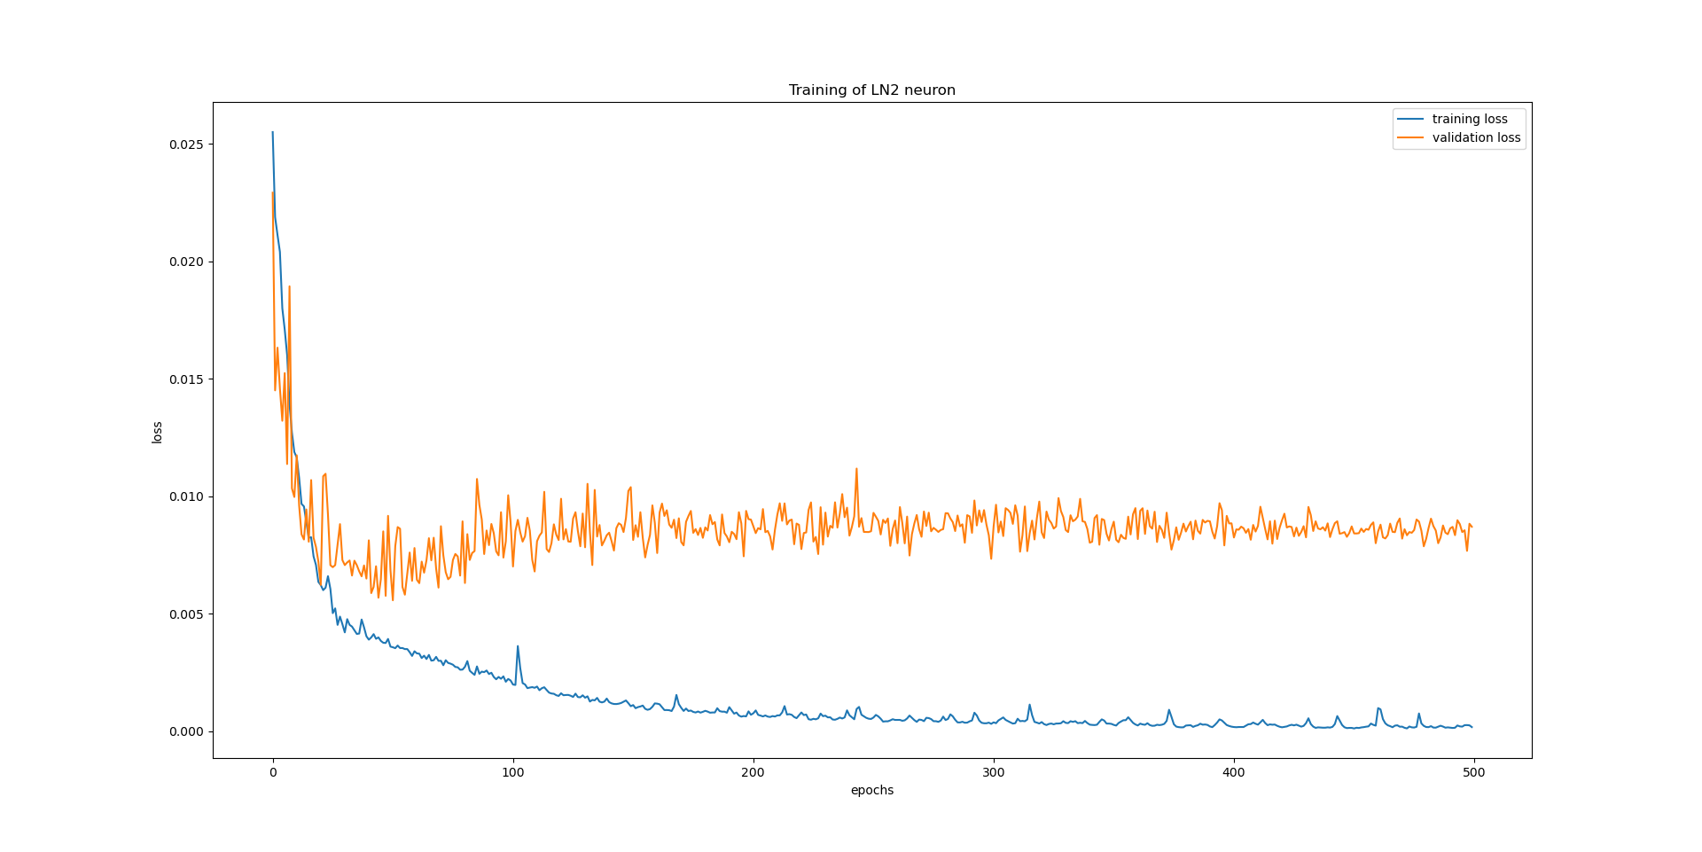
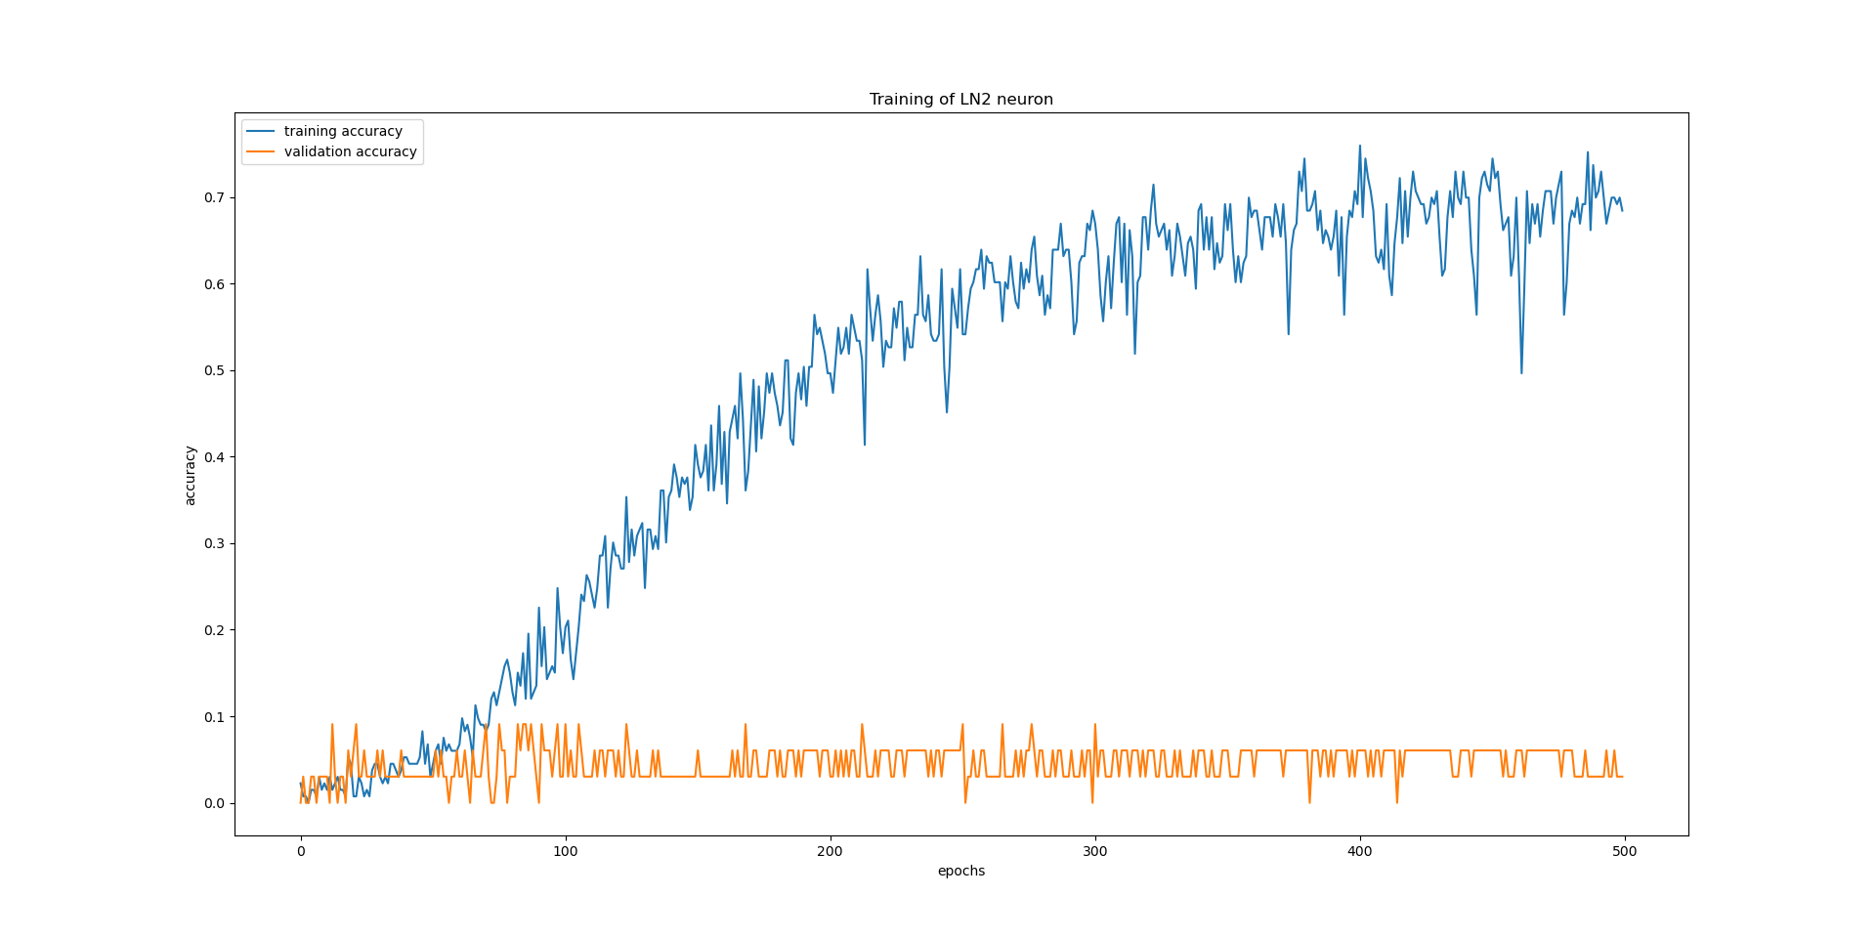
Training curves – LN2
--- Training curves
--- Validation curves

Slide 41
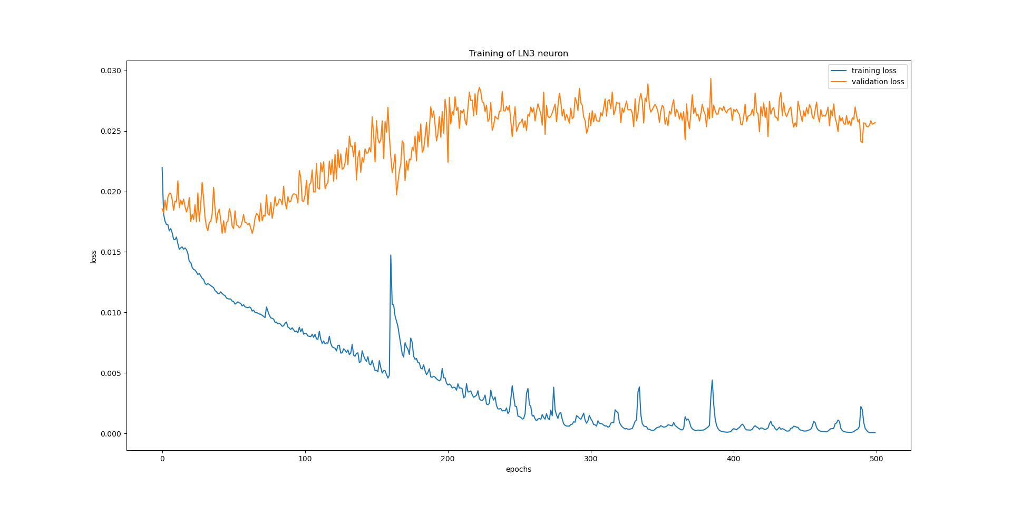
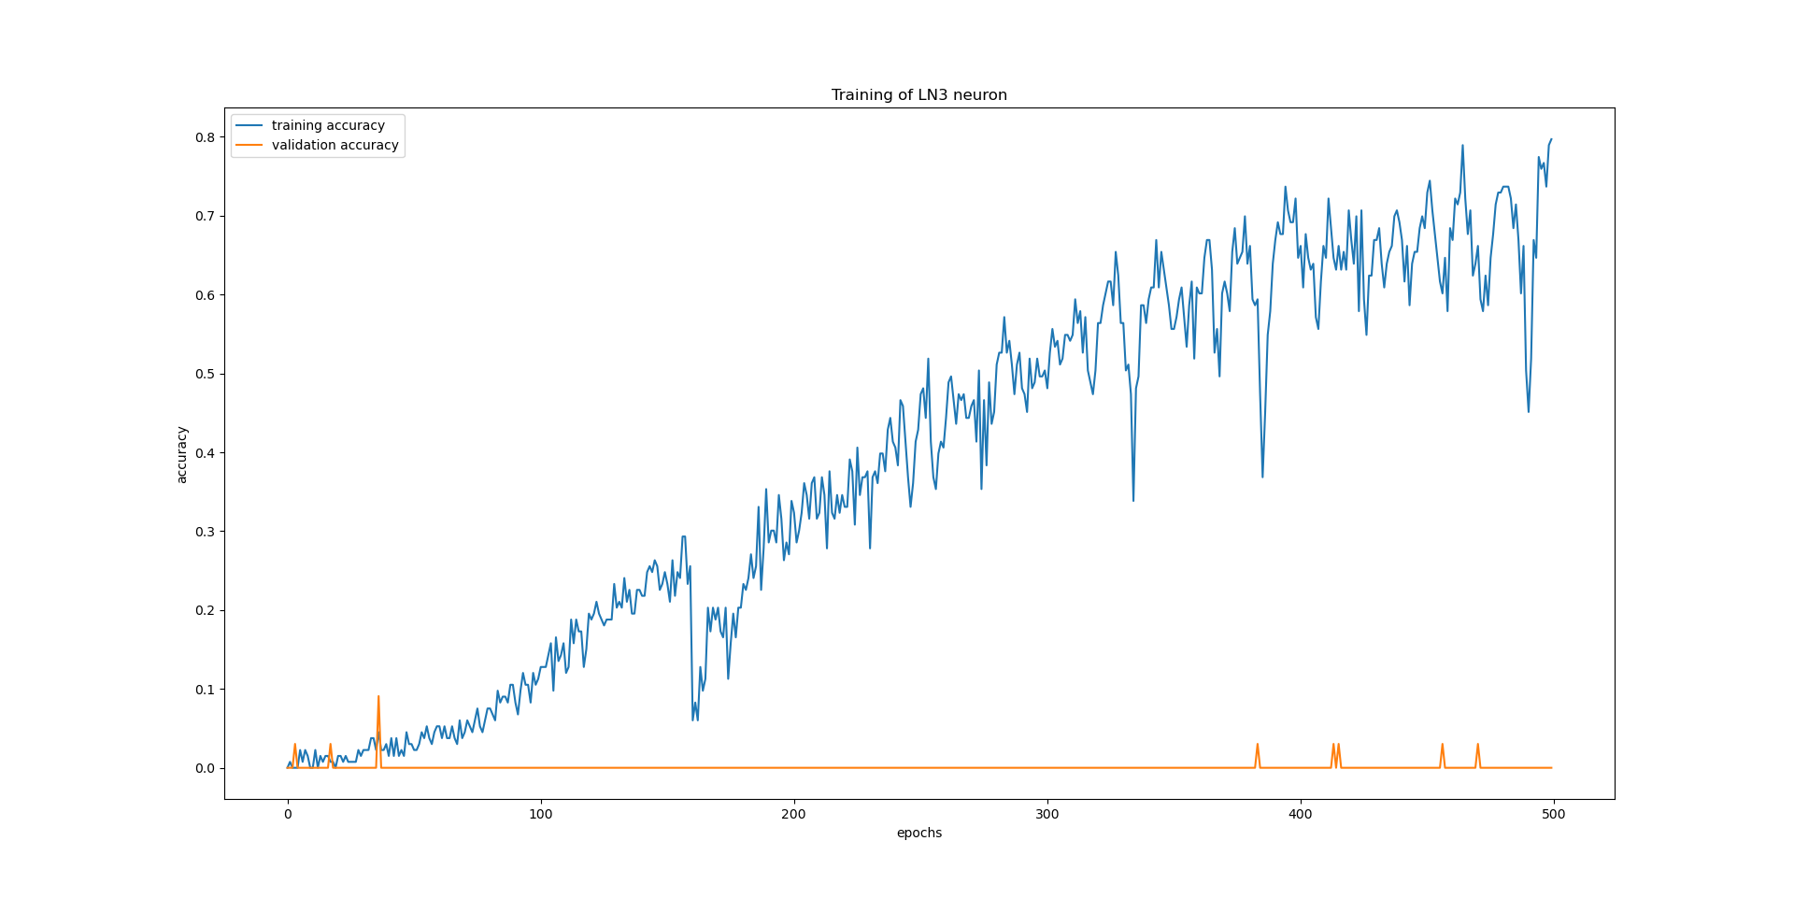
Training curves – LN3
--- Training curves
--- Validation curves

Slide 42
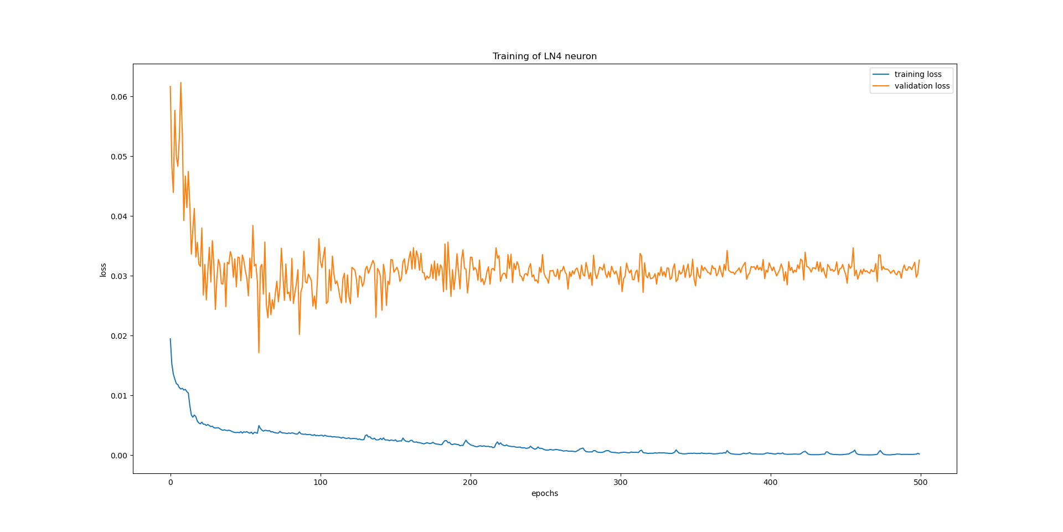
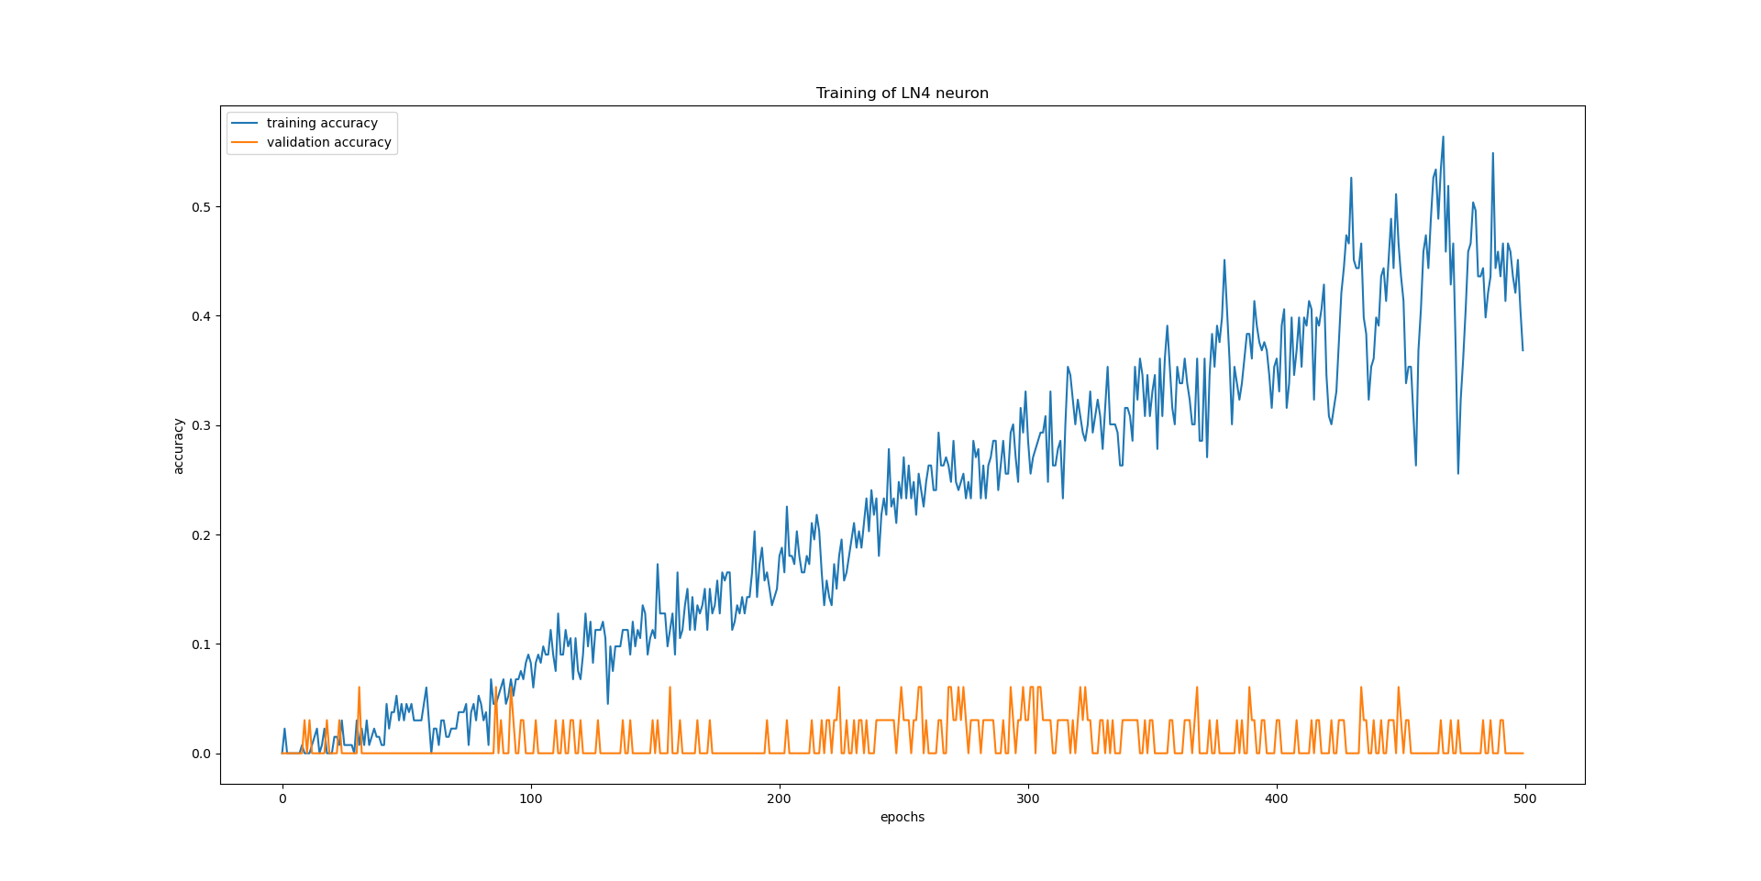
Training curves – LN4
--- Training curves
--- Validation curves

Slide 43
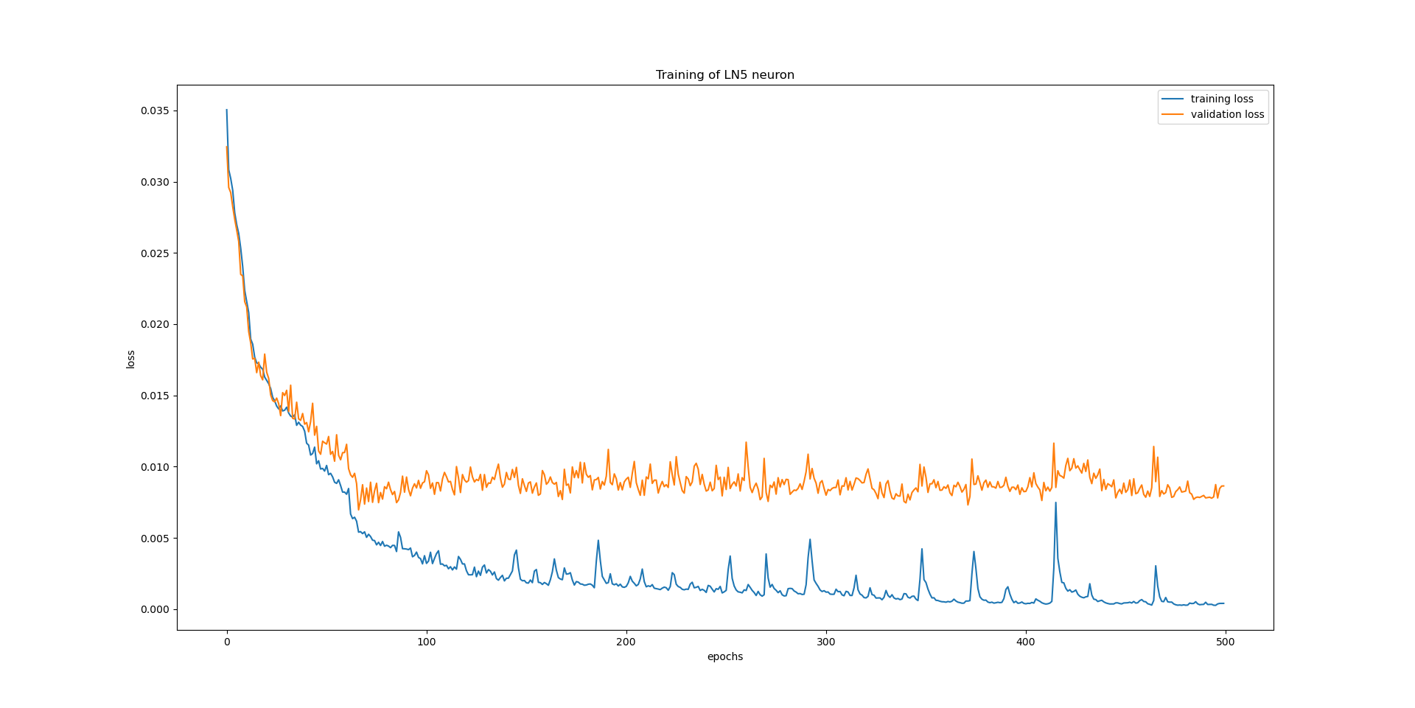
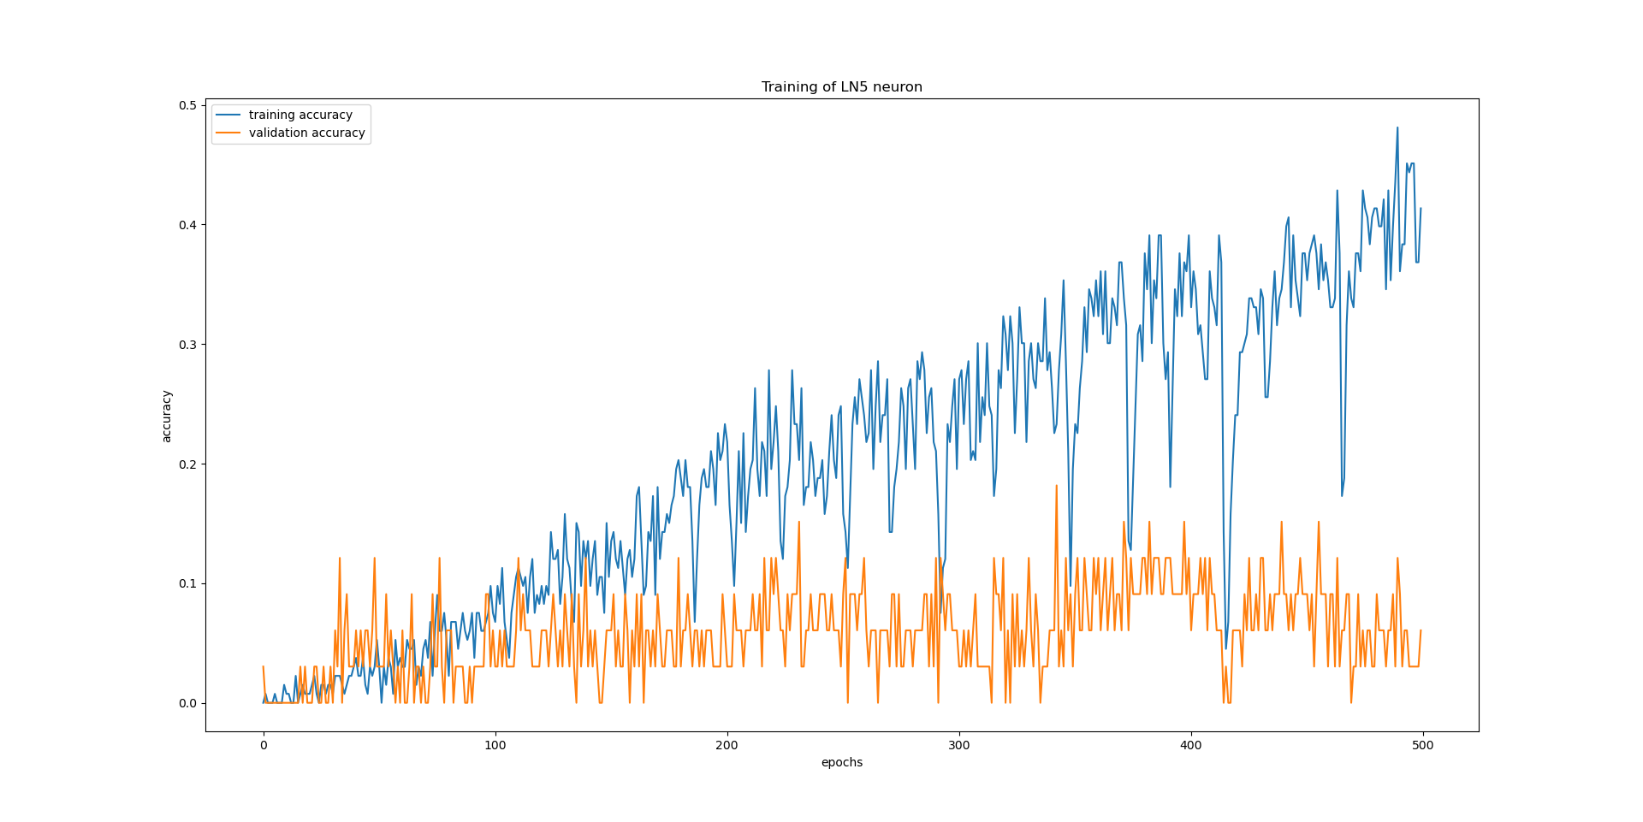
Training curves – LN5
--- Training curves
--- Validation curves

Slide 44
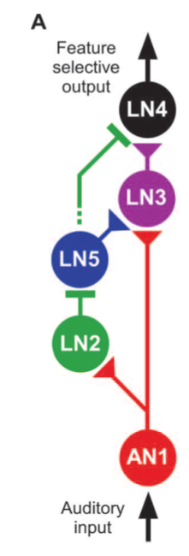
Creating the neural network from trained models
X_ , tmp = truncate_data_and_reshape(X,y1,timesteps,1)
yhat1 = model1_an1.predict(X_)
yhat1_ = yhat1.reshape(-1,1)
yhat1_ , tmp = truncate_data_and_reshape(yhat1_,yhat1_,timesteps,1)
yhat2 = model2_ln2.predict(yhat1_.reshape(-1,timesteps,1))
yhat2_ = yhat2.reshape(-1,1)
yhat2_ , tmp = truncate_data_and_reshape(yhat2_,yhat2_,timesteps,1)
yhat5 = model3_ln5.predict(yhat2_.reshape(-1,timesteps,1))
yhat1_ = yhat1.reshape(-1,1)
yhat5_ = yhat5.reshape(-1,1)
yhat3_ , tmp = truncate_data_and_reshape(np.array([yhat1_,yhat5_]),X,timesteps,2)
yhat3 = model4_ln3.predict(yhat3_.reshape(-1,timesteps,2))
yhat3_ = yhat3.reshape(-1,1)
yhat5_ = yhat5.reshape(-1,1)
yhat4_ , tmp = truncate_data_and_reshape(np.array([yhat3_,yhat5_]),X,timesteps,2)
yhat4 = model5_ln4.predict(yhat4_.reshape(-1,timesteps,2))

Slide 45
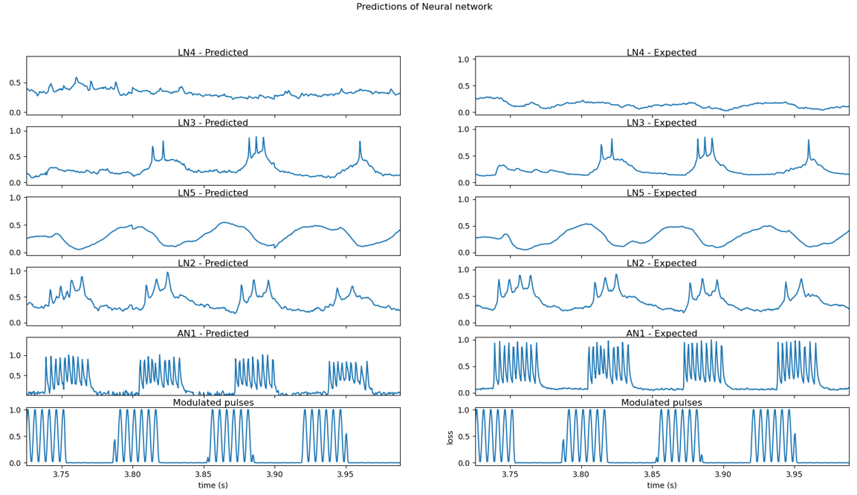
Predictions from neural network
Predicted output
Expected output

Slide 46
TASKS
TASK 1 – Selection of neural network type and performing heuristics.
TASK 2 - Creating identical waveforms as of neuronal data for training and evaluating various neural network models.
TASK 3 - Training the neural network model for actual waveforms of neuronal data.
TASK 4 - Using that model, train all neurons and create a neural network.
TASK 5 - Make the real time predictions on PC by using created neural network model.

Slide 47
TASK 5
Making real time predictions on PC

Slide 48
Code for making real time predictions
CHUNK = 200
WIDTH = 2
CHANNELS = 1
RATE = 2000
log = []
p = pyaudio.PyAudio()
stream = p.open(format=p.get_format_from_width(WIDTH), channels=CHANNELS, rate=RATE, input=True,
output=True,
frames_per_buffer=CHUNK)
while True:
data = stream.read(CHUNK)
#convert the data for prediction
#from bytestream to int16
data = np.frombuffer(data, dtype=np.int16)
#convert between 0 to 1
data_ = scaler_i.transform(data.reshape(-1, 1))
#reshape for prediction
data_ = np.reshape(data_,(1,-1,1))
.
.
.
.
.
.

Slide 49
LIVE DEMO – REAL TIME PREDICTIONS

Slide 50
Conclusion
A neural network model is created which can be trained for neural data of different cricket species.
A neural network gave best performance with Bidirectional LSTM neural networks, as compared to Simple LSTM, Stacked LSTM and Encoder Decoder LSTM.
Overfitting is occurred with 33% training accuracy and 3.3% of validation accuracy, most probable reason could be the limited amount of training data.
Real time predictions are done on PC, in Python environment. Created neural network model is able to predict 200ms of data per second , of all 5 neurons including plotting.

Slide 51
THANK YOU

